Slide 1
Power conversion

Slide 2
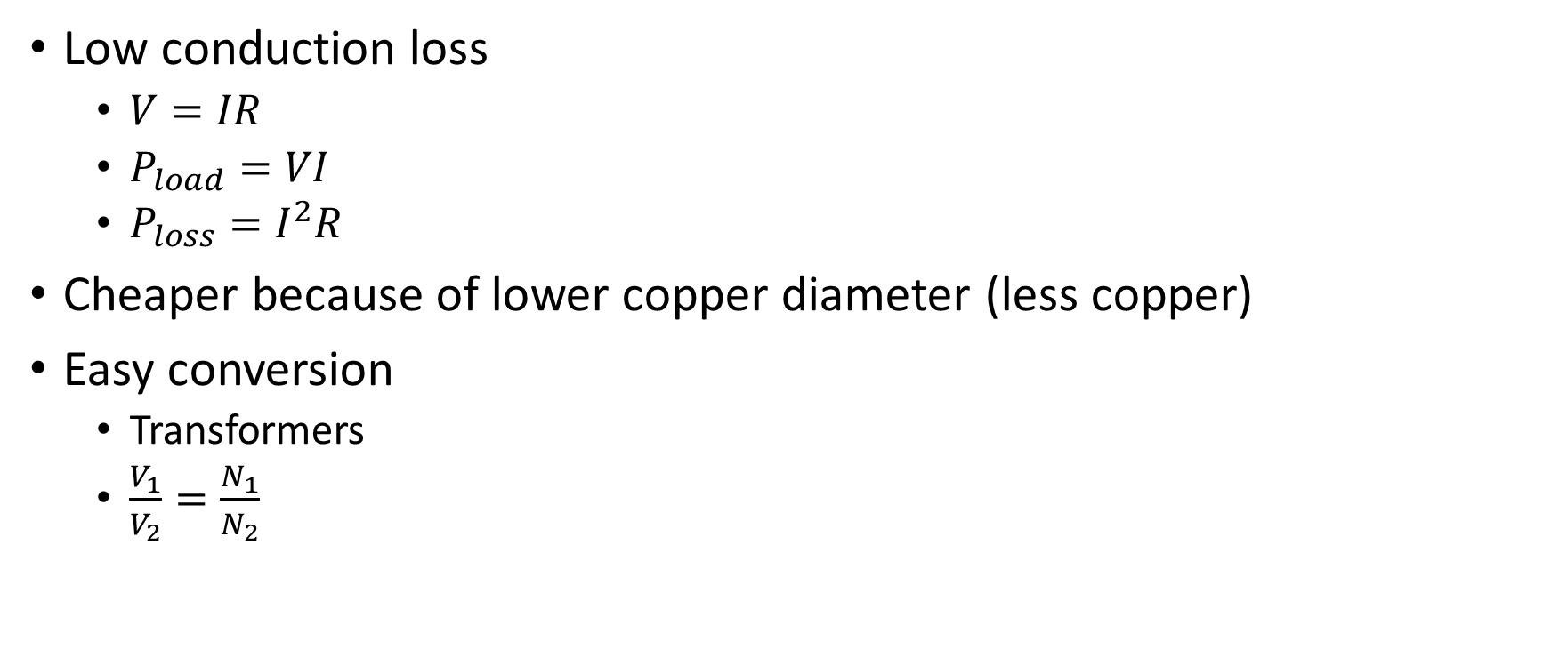
Power transmission likes AC high voltage
Low conduction loss
$V=IR$
$P_{load}=VI$
$P_{loss}=I^{2}R$
Cheaper because of lower copper diameter (less copper)
Easy conversion
Transformers
$\frac{V_{1}}{V_{2}}=\frac{N_{1}}{N_{2}}$

Slide 3
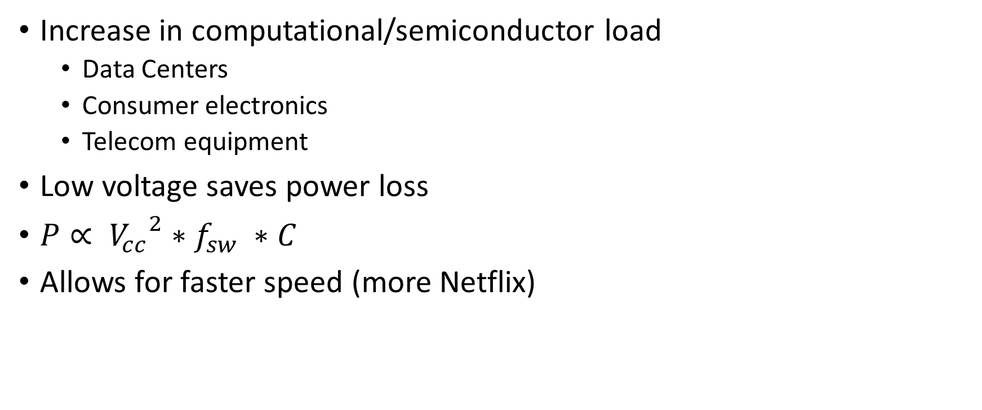
Modern power consumption likes low Voltage DC
Increase in computational/semiconductor load
Data Centers
Consumer electronics
Telecom equipment
Low voltage saves power loss
$P∝ {V_{cc}}^{2}∗f_{sw} ∗C$
Allows for faster speed (more Netflix)

Slide 4
Power conversion is what goes in between
Power generation/distribution
Power conversion
Power consumption

Slide 5
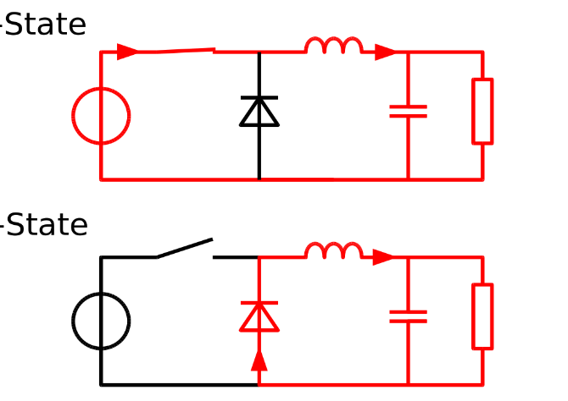
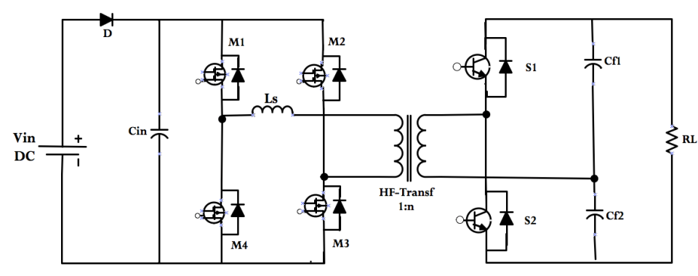
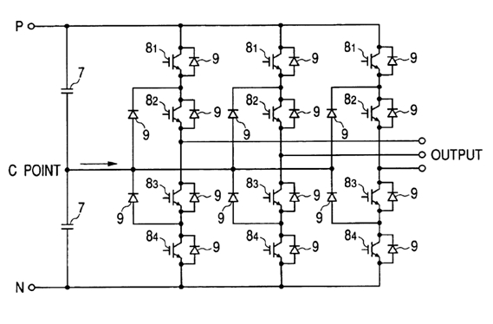
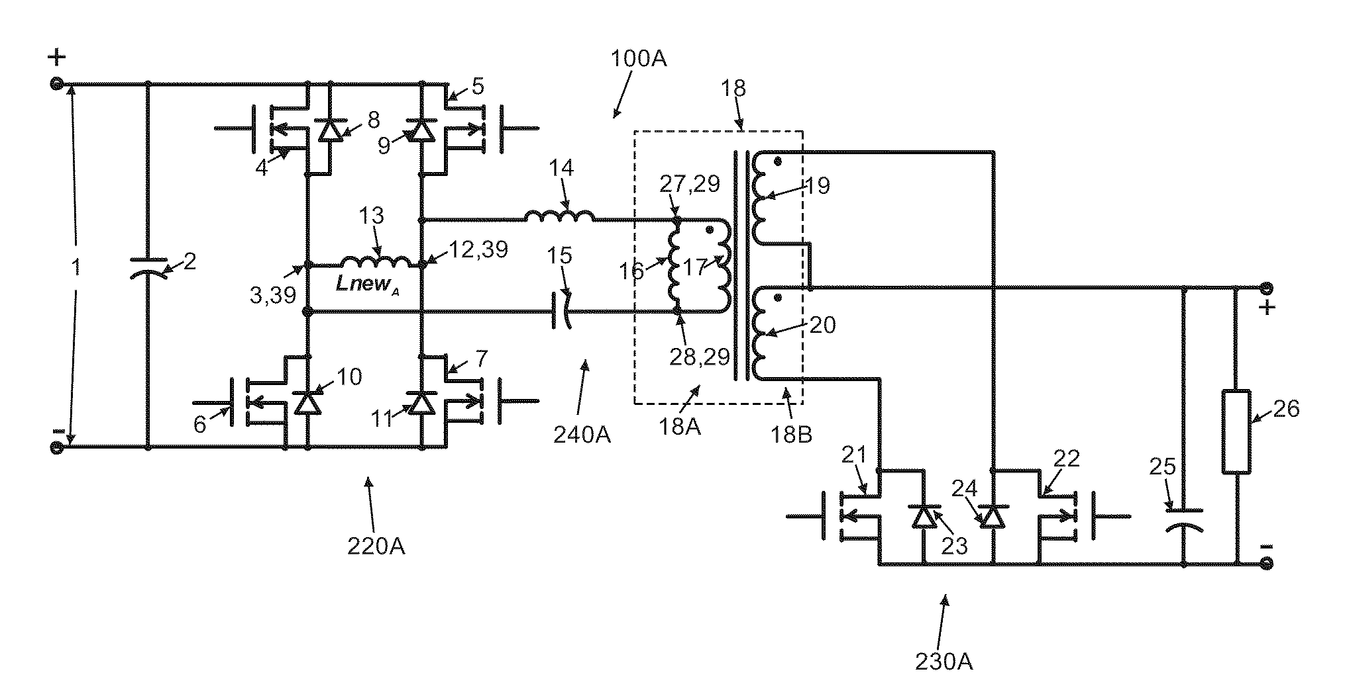
What does a typical power converter looks like

Slide 6
Analog to Digital control
Traditionally control are done via analog methods
Digital control pros
Cheaper
More Flexible
More efficient
Challenges in digital control
High speed PWM
Discrete mathematics
Quantization error

Slide 7
Analog PWM

Slide 8
Basic Digital PWM

Slide 9
More advanced digital PWM

